Slide 1
Behavioral Health Prior Authorization Process
On behalf of Indiana Medicaid

Slide 2
Agenda
Acentra Health
General Authorization Requirements
Provider Responsibilities
Behavioral Health (BH) PRTF & MRO Overview
Tips for Reducing Pends and Administrative Denials
Post Denial Options
Atrezzo Process for Authorization Revisions and Requesting Additional Units

Slide 3



Acentra Health
With over six decades of combined experience, CNSI and Kepro have come together to become:
Currently, Acentra provides services in all 50 states, partnering with 45 state Medicaid agencies and 25 federal agencies.

Slide 4
About Acentra Health:
Acentra Health’s diverse team of experienced leaders, clinicians, technologists, and industry professionals are redefining industry standards and expectations to support your program’s needs.
30+ years of public sector health experience.
Innovative excellence in healthcare technology solutions and clinical expertise.
Best-in-class client experience: subject-matter experts, health care advisory board, board of directors, and client focus groups.
Acentra serves as the PA vendor for Indiana Medicaid FFS since July 1, 2023.

Slide 5
Utilization Management Scope of Services
Durable Medical Equipment (DME)
Audiology
Hospice
Inpatient Medical
Behavioral Health (BH) Psychiatric Residential Treatment Facility (PRTF) & Medicaid Rehabilitation Option (MRO) Services
TBI
Location 22
Outpatient Physical & Occupational therapy
Outpatient Speech Therapy
Physician Administered Drug (PAD)
Imaging/Lab/Genetic
Transplant
Home Health
Dental
Outpatient Surgery
Transportation
Vision
Chiropractic

Slide 6
Acentra Health’s Resources for Providers
Atrezzo: 24-hour/365 days the provider portal can be accessed at: Atrezzo Provider Portal
  Utilization of the Atrezzo portal allows the provider to:
        Request prior authorization for services and communicate with clinical reviewers.
        Upload clinical information to aid in review of prior authorization requests.
        Submit administrative reviews (reconsiderations) and/or peer-to-peer requests for services denied/partially approved.
Provider Education and Outreach, as well as system training materials (including Video recordings and FAQs) are located at: Training & Education - Indiana Medicaid FFS
Provider communication and support email: INPriorAuthIssues@Acentra.com

Slide 7
Timely Submission
A request is considered timely when the request is submitted within 48 hours of admission-not including Saturdays, Sundays, or holidays (unless submitted late due to retrospective Medicaid eligibility).
Acentra’s guides for submitting both outpatient and inpatient requests can be found on our Provider Education Website at: Training & Education - Indiana Medicaid FFS

Slide 8
Retrospective Reviews
A retrospective review occurs when the entire date span of the request has passed prior to submission. This is considered under the following circumstances:
Pending or retroactive member eligibility.
Provider unaware that the member was eligible for services at the time services were rendered. ***PA is granted in this situation only if the following conditions are met:
  The provider’s records document that the member refused or was physically unable to provide the member’s Indiana Health Coverage Programs (IHCP) Member ID.
  The provider can substantiate that reimbursement was continually pursued from the member until IHCP eligibility was discovered.
  The provider submitted the request for PA within 60 calendar days of the date that IHCP eligibility was discovered.
When requesting a retrospective PA, detailed information and documentation to explain the retro request is required.

Slide 9
Provider Responsibilities
Methods for Prior Authorization Submission:
  Atrezzo Provider Portal
  Fax: 800-261-2774
  Phone: 866-725-9991
Please check the FSSA’s Provider Fee Schedules prior to submission to ensure a prior authorization is required for the service being rendered.
Always verify the Member’s eligibility with Indiana Medicaid FFS via the IHCP provider portal.
Ensure that the request is not a duplication of services.
Complete all required forms in its entirety and submit all documentation with request for authorization.
**Prior authorization does not guarantee payment.

Slide 10
General Prior Authorization Requirements
Submitting via Portal
Submitting via Fax
Submitting via Phone
Atrezzo Provider Portal
Case Wizard provides step-by-step guidance through the case submission process.
Upload all required forms and relevant documentation at the time of submission.
Prior Authorization Request Form:
  Member Identification number
  Provider NPI both “Requesting” and “Rendering” (if different)
  CPT; CDT; REV; HCPCS; along with dates of service
  Diagnosis code
  Form must be signed
Submit all relevant documentation at the time of submission.
Provider must provide all the information from the Prior Authorization Request Form.
Then submit all relevant documentation either via portal, mail, or fax.
*Abbreviations: Dates of service (DOS), National Provider Identifier (NPI), Current Procedural Terminology (CPT), Current Dental Terminology (CDT), Revenue code (REV), & Healthcare Common Procedure Coding System (HCPCS)

Slide 11
Behavioral Health

Slide 12
BH Documentation- Supervising Practitioners
Qualified Practitioners Who Can Supervise Treatment Plans
  Licensed physician (including licensed psychiatrist).
  Licensed health service provider in psychology (HSPP).
  Licensed clinical social worker (LCSW).
  Licensed mental health counselor (LMHC).
  Licensed marriage and family therapist (LMFT).
  Licensed clinical addition counselor (LCAC).
  Licensed advanced practice registered nurse (APRN) with a master’s degree in nursing with a major in psychiatric or mental health nursing from an accredited school of nursing.

Slide 13
Psychiatric Residential Treatment Facilities Submission Details
Must be submitted with U3 modifier when requested by provider for DCS placed children (for billing purposes).
Fee-For-Service members or the following Managed Care Entities (MCE):
  Hoosier Care Connect (HCC) & Hoosier Healthwise (HHW).
Must be younger than 21 years old on day of admission.
Per Diem-1 unit = 1 day.
Request in 30 day/unit increments.
Criteria for PRTF reviews: Provider Reference Module: Behavioral Health Services

Slide 14
PRTF Documentation Requirements-Admission
PRTF Admission Assessment Request Tool.
Intake Assessment & Initial Treatment Plan.
Child and Adolescent Needs and Strengths (CANS) assessment no more than 30 days old.
Physician history and physical (H&P) no more than 90 days old.
Documentation indicating the severity of the member’s mental disorder.
Clinical documentation from the most recent inpatient treatment:
    Current inpatient treatment plan.
    Nursing notes.

Slide 15
PRTF Documentation Requirements-Concurrent
Prior Authorization request must be submitted prior to or on the first non-covered day.
Documentation:
  PRTF Extension Request Tool.
  (CANS) Assessment no more than 90 days old.
  Master Multidisciplinary Treatment Plan.
  Individual therapy notes.
  Family therapy notes.
  Physician and nursing notes.
  Discharge plan with specific planned discharge date.
  Any therapeutic leave/passes.

Slide 16
PRTF Documentation Requirements-Readmission
Prior Authorization request:
  Prior to readmission or on day of readmission.
Documentation:
  PRTF Admission Assessment Request Tool.
  Intake Assessment.
  CANS assessment no more than 30 days old.
  Physician H&P no more than 90 days old.
  Initial Treatment Plan.
  Documentation indicating the severity of the member’s mental disorder.
  Documentation indicating that intermediate or long-term care in a secure facility is needed for the member.

Slide 17
PRTF Readmission Documentation Cont.
  Clinical documentation from the most recent inpatient treatment:
    Current inpatient treatment plan.
    Nursing notes.
  Clinical documentation that explains:
    Failure of previous discharge plan to use a less restrictive setting, including services or interventions that were attempted successfully or unsuccessfully.
    Any significant changes in the member or the family situation that could have led to decrease in stability or increase in psychiatric symptoms.
    An estimated length of stay and recommendations for treatment goals and interventions during this stay.
    The significant changes that must occur during this stay for the member to successfully transition to a less restrictive setting.

Slide 18
Medicaid Rehabilitation Options Services

Slide 19
Medicaid Rehabilitation Options Services (MRO)
MRO services are designed to assist members in regaining a previous level of functioning that had been lost. Only members with a qualifying diagnosis and level of need (LON) are eligible for an MRO service package in addition to the outpatient behavioral health services covered under the Indiana Medicaid State Plan.
Data Assessment Registry for Mental Health and Addiction Medication (DARMHA) determines & assigns all service packages.

Slide 20
Scenarios for Requesting MRO services
If the member needs a medically necessary MRO service not assigned in their MRO service package, then a new PA separate from the package needs requested for those services.
If a member does not have a qualifying MRO diagnosis or LON & has a significant behavioral health need that requires a medically necessary MRO service, then a new PA would need to be requested for those services.
If member has existing MRO package & the service is included in that package, then a request for additional units.
A member is newly eligible to the Medicaid program or a member without an MRO package had a lapse in their Medicaid eligibility and was determined Medicaid eligible for a retroactive period. In this case, a retroactive request for PA is appropriate for MRO services.

Slide 21
Medicaid Rehabilitation Option Services
The assigned MRO service packages are designed to meet the member’s needs. However, for members who require additional medically necessary services, providers can submit a PA for additional units and/or services.
Request for additional units can be submitted via Atrezzo, phone, or fax.
  Fax- 800-261-2774.
    Requires the Authorization revision request form. Forms
  Phone- 866-725-9991.
  Acentra Health’s Provider Portal Atrezzo.
Ensure that all required documentation is uploaded with request.
***Note: For all the scenarios presented, MRO service providers are required to submit documentation that supports medical necessity.

Slide 22
MRO Documentation Requirements
Member’s most current Level of Need (LON):
  If documenting a change in LON, the new assessments needs to be provided:
    Child and Adolescent Needs and Strengths (CANS).
    Adult Needs and Strengths Assessment (ANAS).
Primary ICD-10 diagnosis code.
Date units will be exhausted:
  Rationale of why units have exhausted prior to the end of the service package.
Frequency and duration of services:
  Hours/minutes per session.
  Number of sessions per day/week/month.

Slide 23
MRO Documentation Requirements Continued
Location or setting where services being provided.
Individual symptoms or issues being addressed with treatment.
Individualized Integrated Care Plan (IICP):
  Current and updated.
  Focus on recovery.
  Reflects progress towards goals.
Transition plan for member to less restrictive level of care.

Slide 24
Frequently Missing Documentation
Goals and Objectives:
  Need to be specific to the member and have measurable outcomes.
  What is being used to measure outcomes and progress.
  What modifications to the interventions are being made when member has lack of consistent progress.
Treatment modalities being used for each service:
  Needs to outline specifically, what is being done.
Progress notes demonstrating the member’s measurable progress towards goals.

Slide 25
CCBHC MRO Requirements
The CCBHC providers will not be submitting packages through DARHMA.
The CCBHC providers will submit a PA when the member’s LON is above and beyond a LON 4 and all units have been exhausted.
CCBHC Providers must submit at least 1 federally required screening tool. (Please note that under the CCBHC program, the CANS or ANSA are not required documents)

Slide 26
General Reasons for Denials and Voids
ADMINISTRATIVE DENIALS:
Untimely notification of admission/concurrent requests.
MEDICAL NECESSITY DENIALS:
Does not meet medical necessity.
PARTIAL APPROVALS:
Dates/units may be modified according to date of submission.
Medical Necessity has not been met for the entire requested service.
VOIDS:
The request is a duplicate of another authorization submitted to Acentra Health.

Slide 27
Common Reasons for Pending
Lack of documentation of the following:
  Screening/Assessment tools for MRO and PRTF.
  Progress/Therapy notes for ongoing services for MRO and PRTF.
  Correct signatures on required documentation.
Notes:
Talking Points:
Submitting all documentation at time of submission including those above, will decrease the amount of pends and admin denials you will receive.

Slide 28
Prior Authorization Review Process
After submission of a request, one of the following actions will occur:​
  Approval: Request met criteria either at nurse review level or medical director review.
  Pended request for additional information: Required documentation is requested when not included with the original submission.

Slide 29
Prior Authorization Review Process Continued
  Administrative Denial:
  Denial of services due to:
    Untimely Request
    Requested information not received
  ​Medical Necessity Denial:
  Physician has determined that medical necessity has not been met.
  The Physician may partially approve or fully deny a request.​

Slide 30
Administrative Review/Reconsideration
  If an administrative denial or medical necessity denial is issued, the provider can request an Administrative Review (also known as Reconsideration).
  A provider requesting review of the modification or denial of a PA must submit a written request for an administrative review within seven business days of the receipt of notification of modification or denial.
  How to request an administrative review:
    Request from the “actions” drop down in the Provider Portal.
    Fax written request.
    Provider module contains details of what is required to initiate an administrative review: Prior Authorization Module
  The review will be completed within 7 business days of receipt.
Notes:
Talking Points:
* Must be a formal request with all documents noted in the bulletin and module

Slide 31
Peer-to-Peer
  Providers may request a Peer-to-Peer on a medical necessity adverse determination.
  Requests for a peer to peer must be made within 7 business days plus 3 calendar days of the date provided on the initial adverse determination letter.
  To request a peer to peer:
    Request from the “actions” drop down in the Provider Portal. Provide the ordering provider’s full name, phone number, and three dates and times of availability.
    Call Customer Service at 866-725-9991.
    Once an agreeable date and time have been identified, a representative will contact (via telephone) the provider with the confirmed date and time. A note will also be placed in the case that is visible to the provider.

Slide 32
Turnaround Times
The turnaround time for completion of a prior authorization review ensures: ​
​A thorough and quality review of all requests by reviewing all necessary & required documentation when it is received.
Ensuring a prompt decision is made to facilitate member care.
Standard
Expedited review
5 business days
48 clock hours
Concurrent Review
Retrospective Review
48 clock hours
30 calendar days

Slide 33
Process for Requesting additional units for MRO & Requesting concurrent review for PRTF
Notes:
Talking Points:
Atrezzo process is the same as far as buttons to select. I will go over the difference between requirements and then cover screenshots of the system.

Slide 34
Process For Requesting Additional Units on MRO
To request additional units, providers will need to extend the existing PA by selecting the extend button within the case or from “actions” drop down for the case in the queue.
The user will need to update the start date to reflect the original dates of service on the package.
Provider can delete all additional codes that do not need to be extended. (Each code will have a trash can icon)

Slide 35
Requesting PRTF Concurrent Reviews
To request Concurrent reviews for PRTF cases, providers will need to extend the existing PA by selecting the extend button within the case or from “actions” drop down for the case in the queue.
The date will default to the day following the last day on the previous request line.
Be certain to enter the duration and quantity.

Slide 36
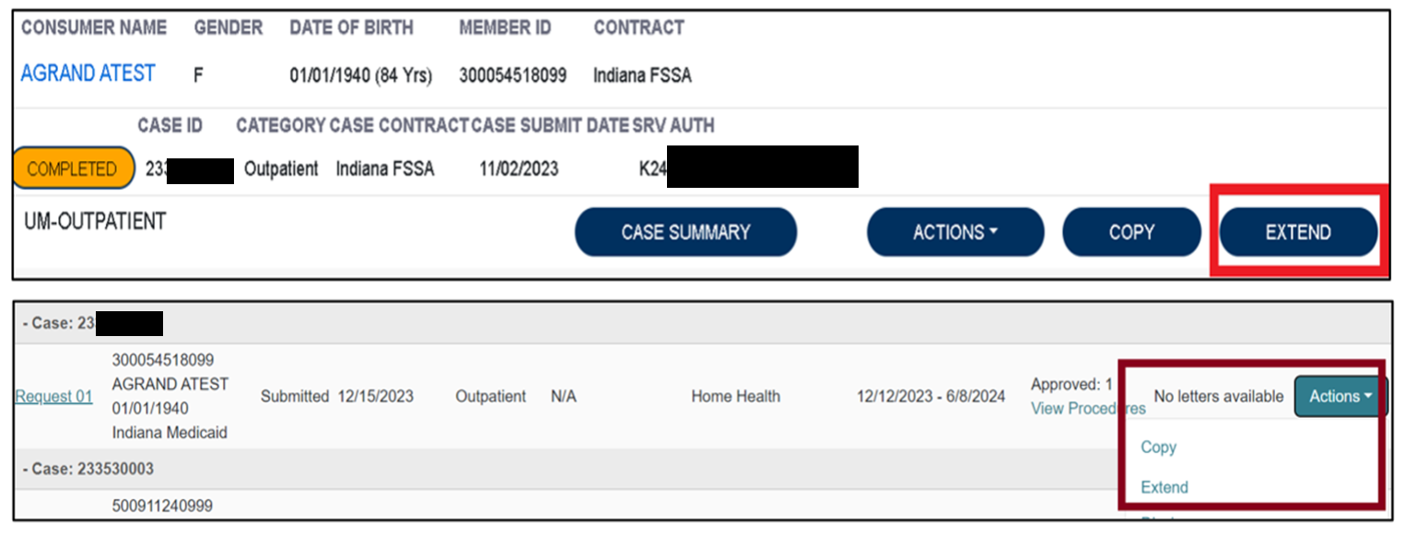
Extend Function in Atrezzo
To begin, the user will choose to extend the existing PA. This can be done from the work queue view or within the case itself.

Slide 37
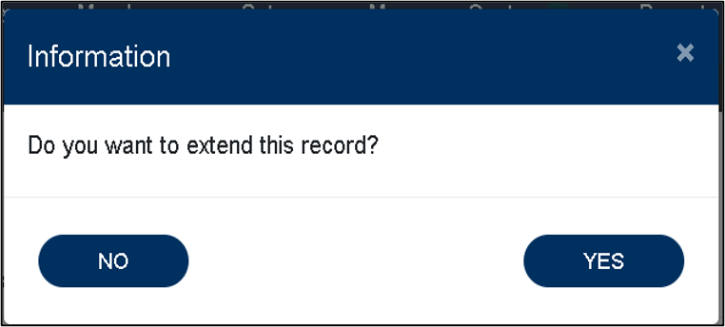

Extend Function in Atrezzo continued
The system will ask the user to verify the action by clicking YES.
Next the system will populate the case summary. Here the user will scroll to the Clinical section and select the down caret to expand the section.

Slide 38
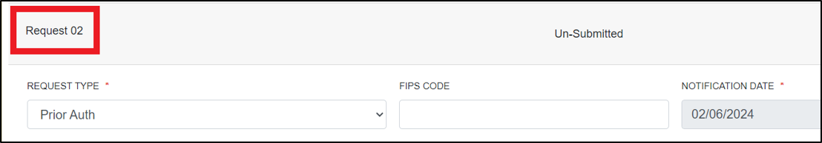
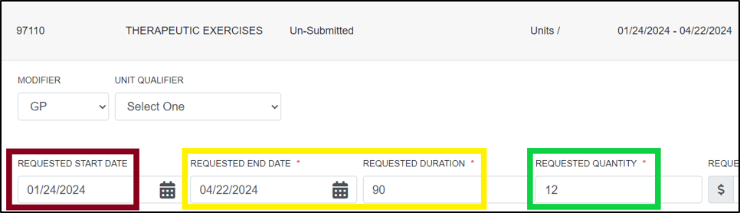
Updating Duration and Quantity
The user will then scroll to the new request line.
The user will review the duration and quantity being requested on the concurrent review.

Slide 39
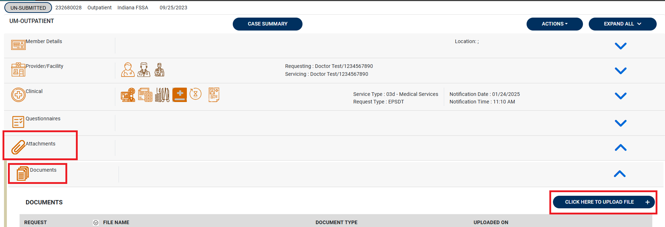
Uploading Documents and Attestation
Once the request line has been updated to reflect the new quantity and duration, the user will need to upload documentation under the attachments section.
The user will scroll to the bottom of the screen and check the box acknowledging that the PA is not a guarantee of payment and only identifies medical necessity, not benefits. The user will then click the submit button.

Slide 40
FSSA Resources for Providers
Provider Bulletins:
Found in the providers references section. Guides providers on requirements.
Indiana Medicaid: Providers: IHCP Bulletins
Provider Modules
  Found in the providers references section. Guides providers on requirements.
  Provider Modules
Forms
  If prior authorization request requires forms to be submitted with the request, they can be found on the forms page.
  Forms

Slide 41
Conclusion and Q&A
Thank you for your time and participation!
Provider Relations Assistance:
INPriorAuthIssues@acentra.com
Provider education website:
Training & Education - Indiana Medicaid FFS
Acentra Health Customer Service:
Phone: 866-725-9991
Fax: 800-261-2774

Slide 42
Closing slide

